Slide 1
There are 6 hidden words. Where are they?

Slide 3
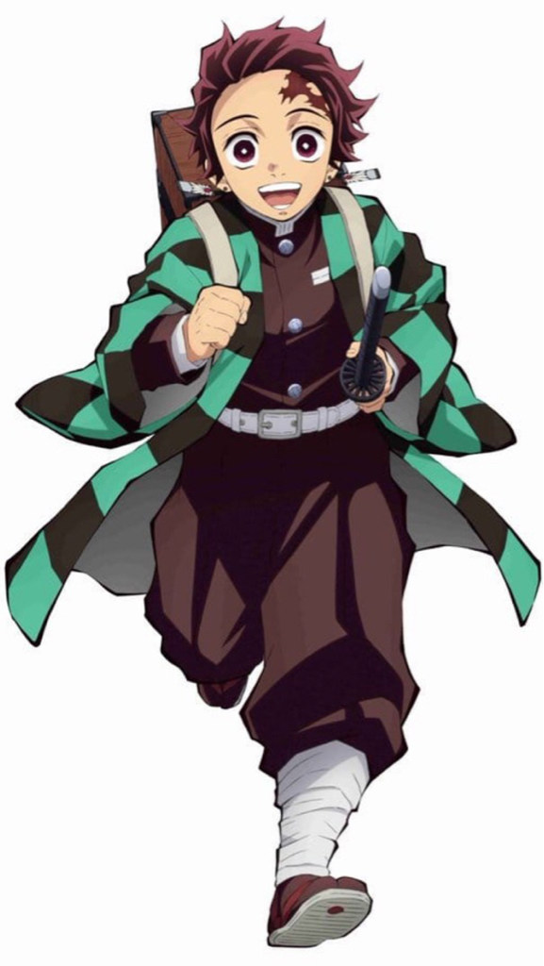
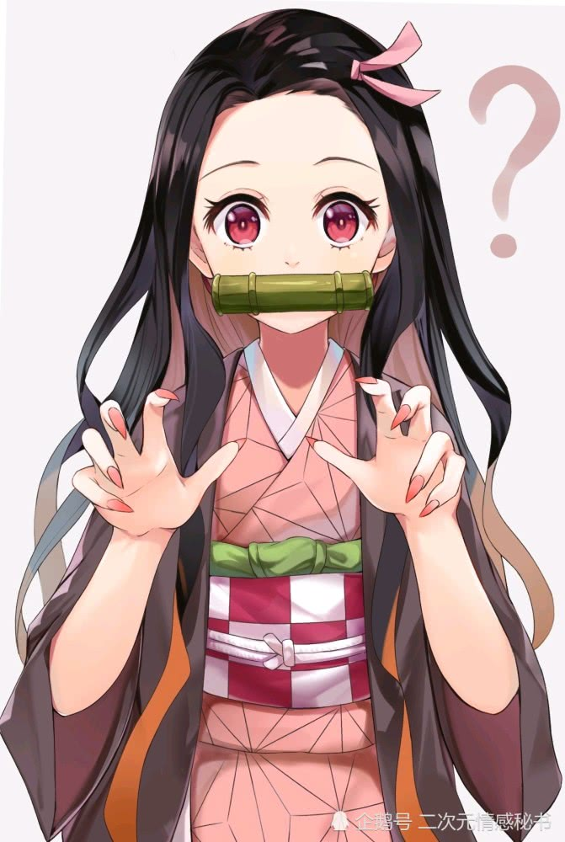
Did you finish your homework?
Maybe…yes!

Slide 4
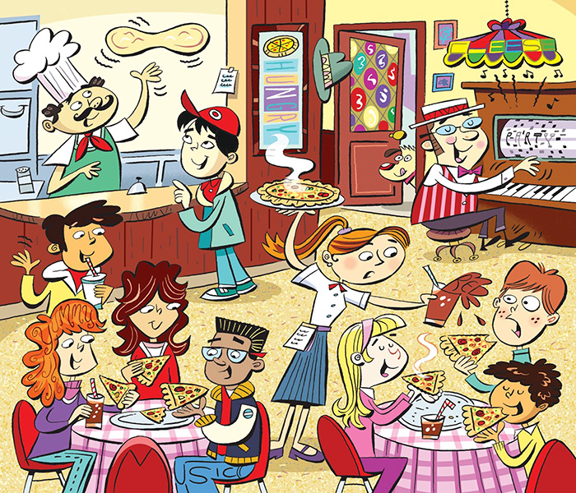
There are 6 hidden words. Where are they?

Slide 6
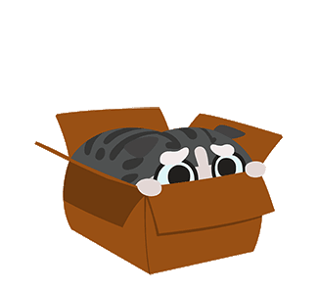
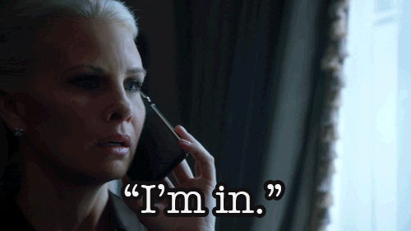
Let me in!
in
I’m in!

Slide 7
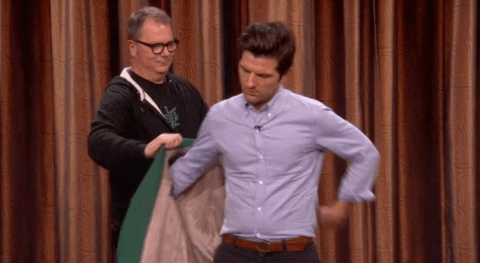
on my way
on
put on

Slide 8
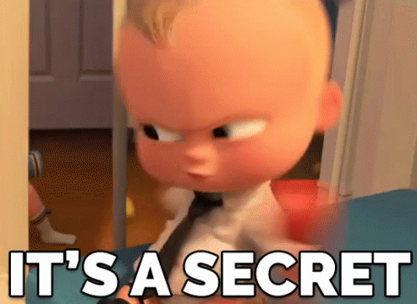
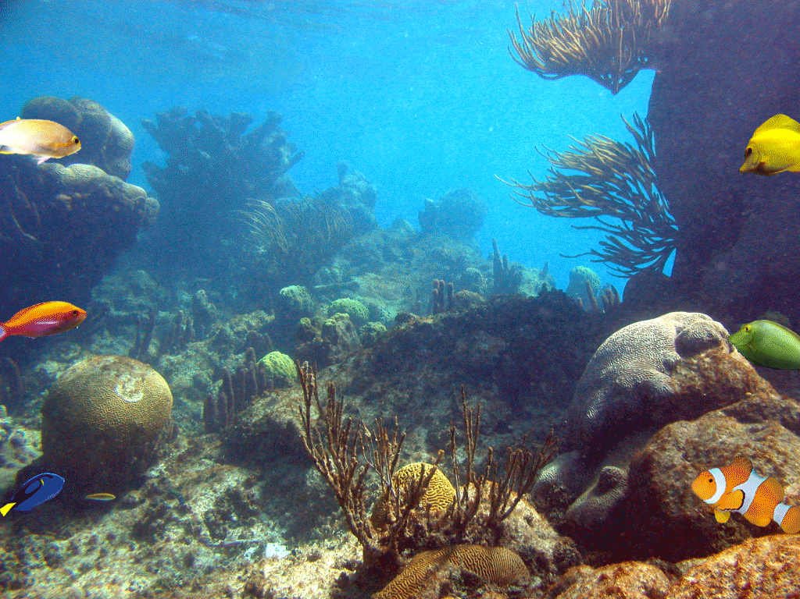
under the table
under
under the sea

Slide 9
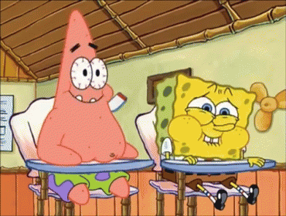
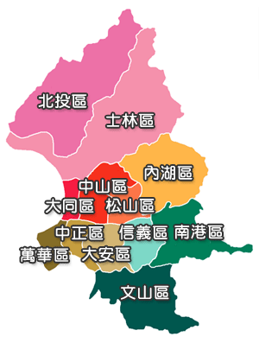
sit next to me
next to
XinYi District is next to…

Slide 10
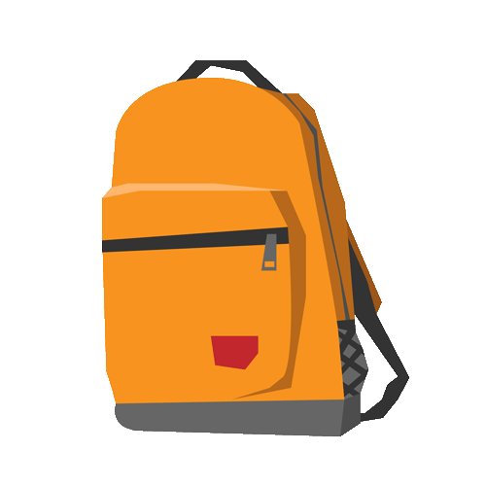
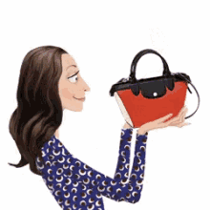
bag
a backpack
a purse

Slide 11
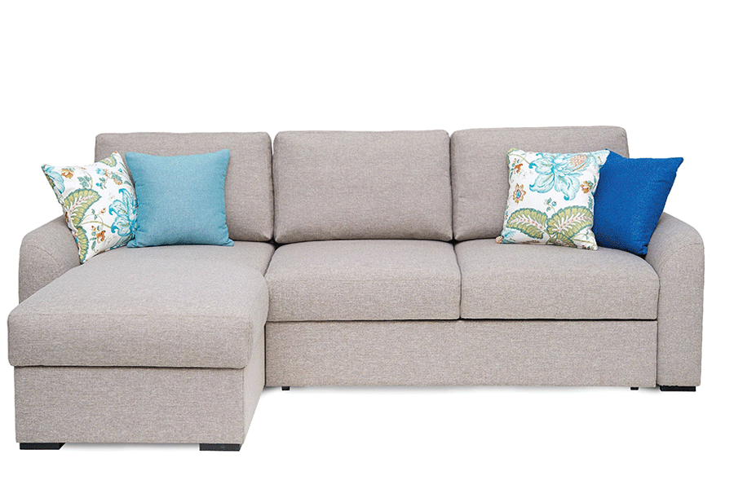
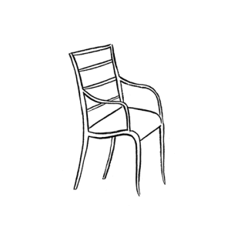
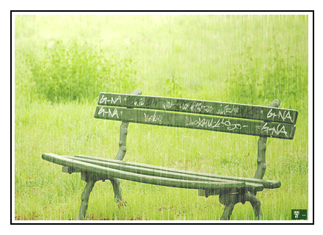
chair
a sofa
a bench

Slide 12
desk
school desk
office desk

Slide 13
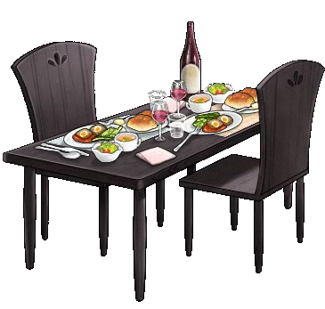
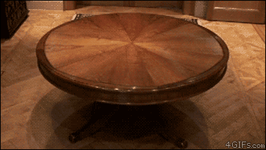
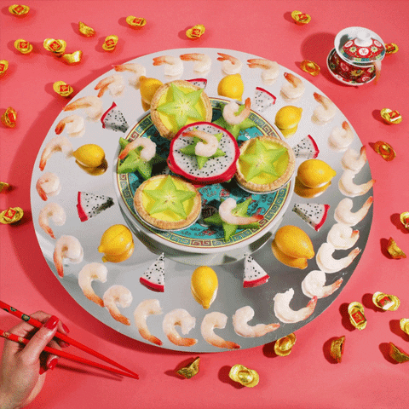
table
dining table
lazy Susan

Slide 14
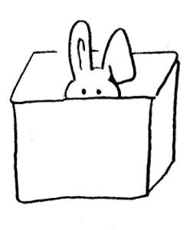
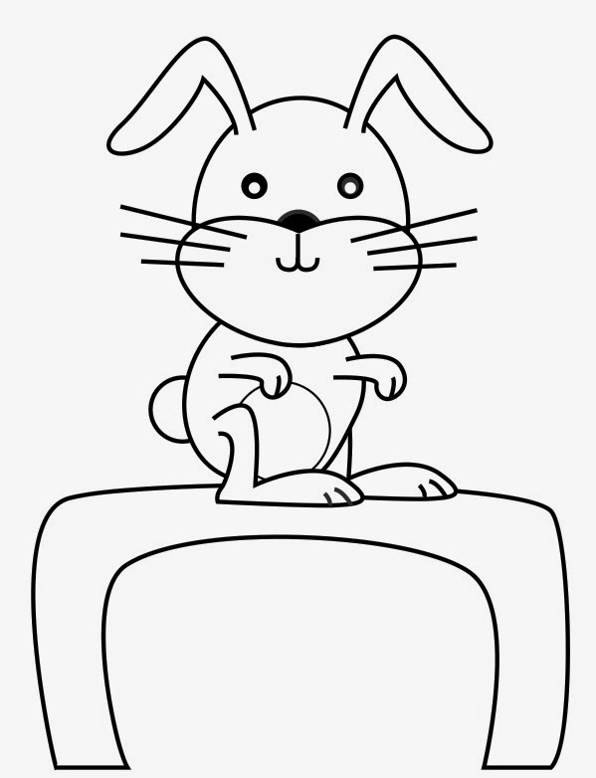
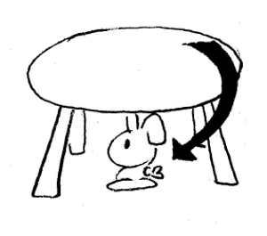
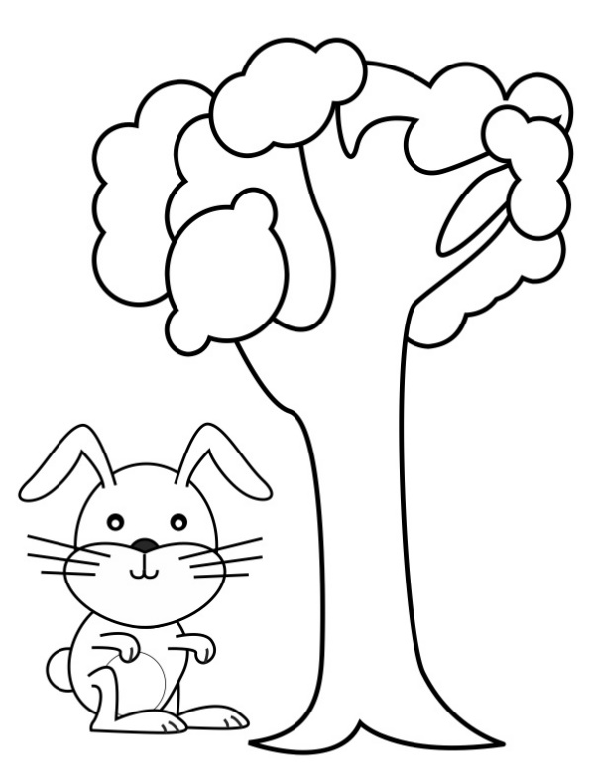
Prepositions
in on under next to
Mandy Says……

Slide 15
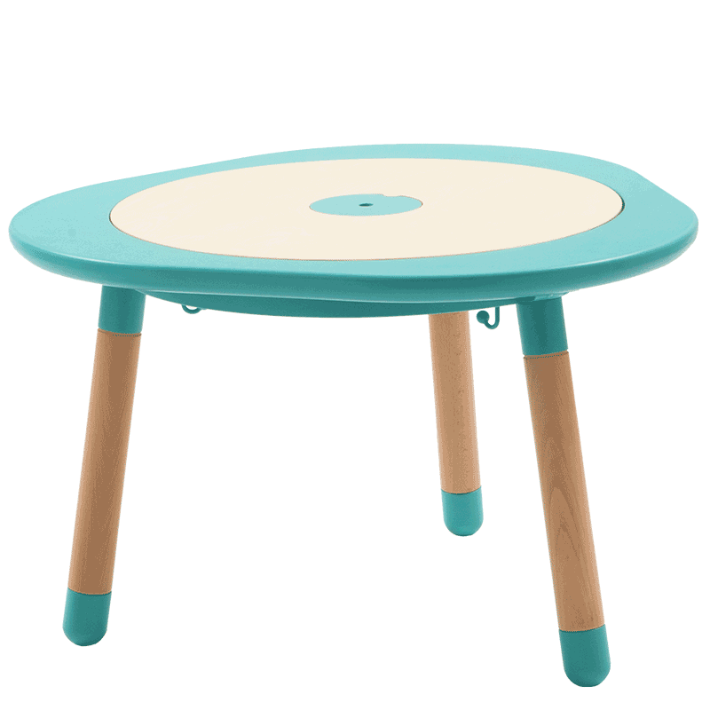
Objects
table
chair
bag
desk

Slide 16
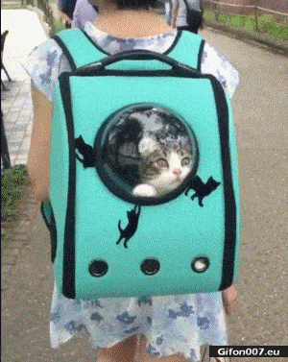
Where is the cat?
It’s ___ the bag.
in
in / on /
under/ next to

Slide 17
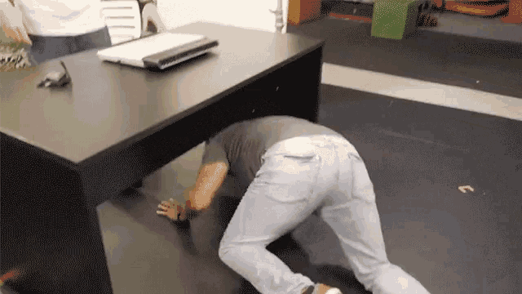
Where is the man?
He’s ____ the
desk.
under
in / on /
under/ next to

Slide 18
Where is the mushroom?
It’s ___ the chair.
on
in / on /
under/ next to

Slide 19
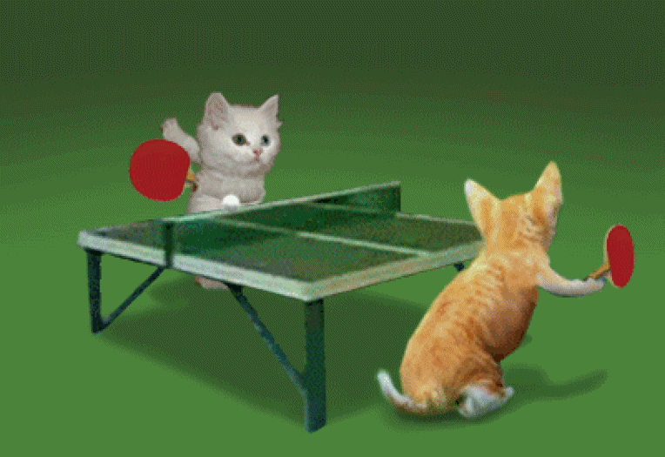
Where are the cats?
They’re ______
the table.
next to
in / on /
under/ next to

Slide 20
Where is Pikachu?
It’s __ the box.
in
in / on /
under/ next to

Slide 21
Where is the man?
He’s __ the ball.
on
in / on /
under/ next to

Slide 22
Where are the eggs?
under
They’re ____ the penguins.
in / on /
under/ next to

Slide 23
Where is Belle?
She’s ______ the bad guy.
next to
in / on /
under/ next to

Slide 25
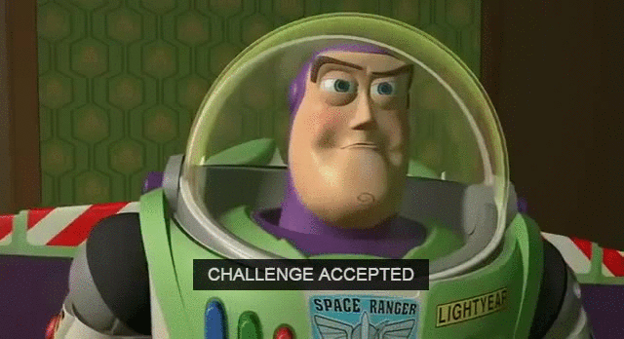
Challenge Time: Look. Write. Show.

Slide 26
The pony is ______ the desk.
in
on
under
next to

Slide 27
The cat is ______ the rabbit.
in
on
under
next to

Slide 28
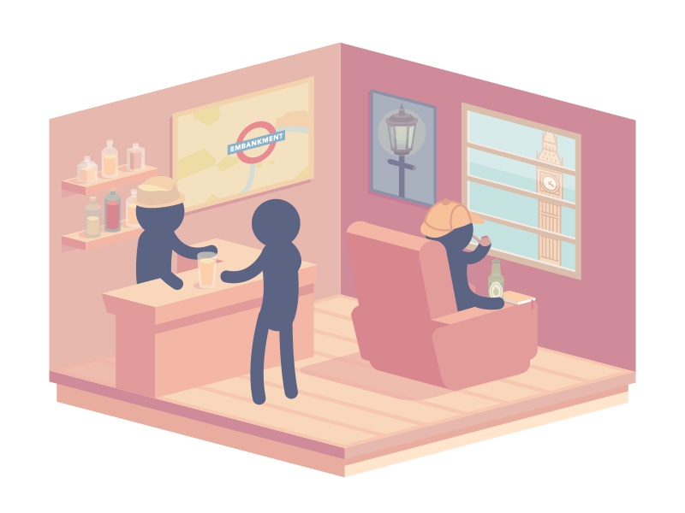
They are ______ the store.
in
on
under
next to

Slide 29
The cow is ______ the car.
in
on
under
next to

Slide 30
The worms are ______ the stone.
in
on
under
next to

Slide 31
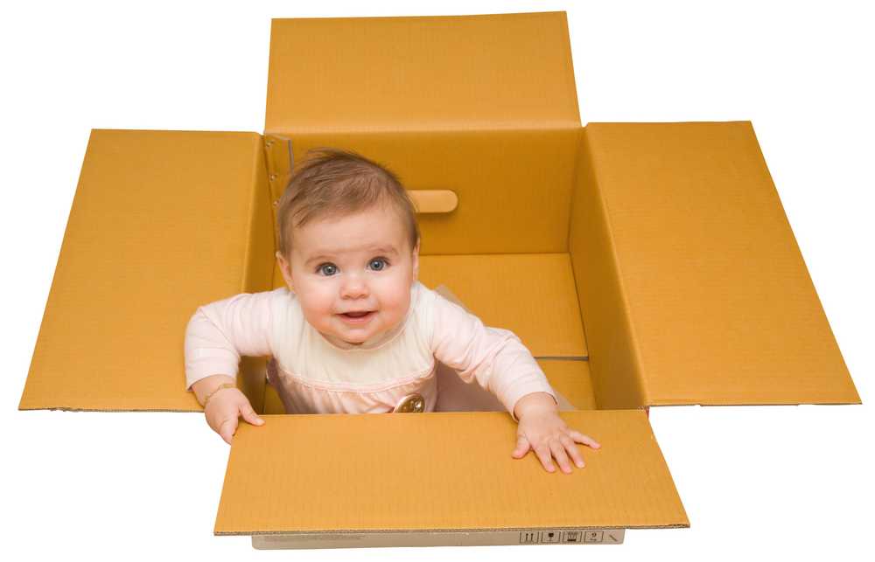
The baby is ______ the box.
in
on
under
next to

Slide 32
The spider is _____ the roof.
in
on
under
next to

Slide 33
The pigs are ______ the tiger.
in
on
under
next to

Slide 34
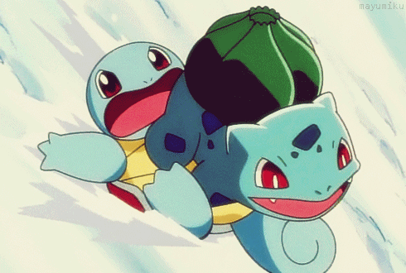
Squirtle is ______ Bulbasaur.
in
on
under
next to

Slide 35
Newton is ______ the apple tree.
in
on
under
next to

Slide 36
Scorekeepers count the points!

Slide 38
Make your own sentences!!
Where is ______?
He/She/It is _____ the _______.
Where are ________?
They are _____ the _______.

Slide 39
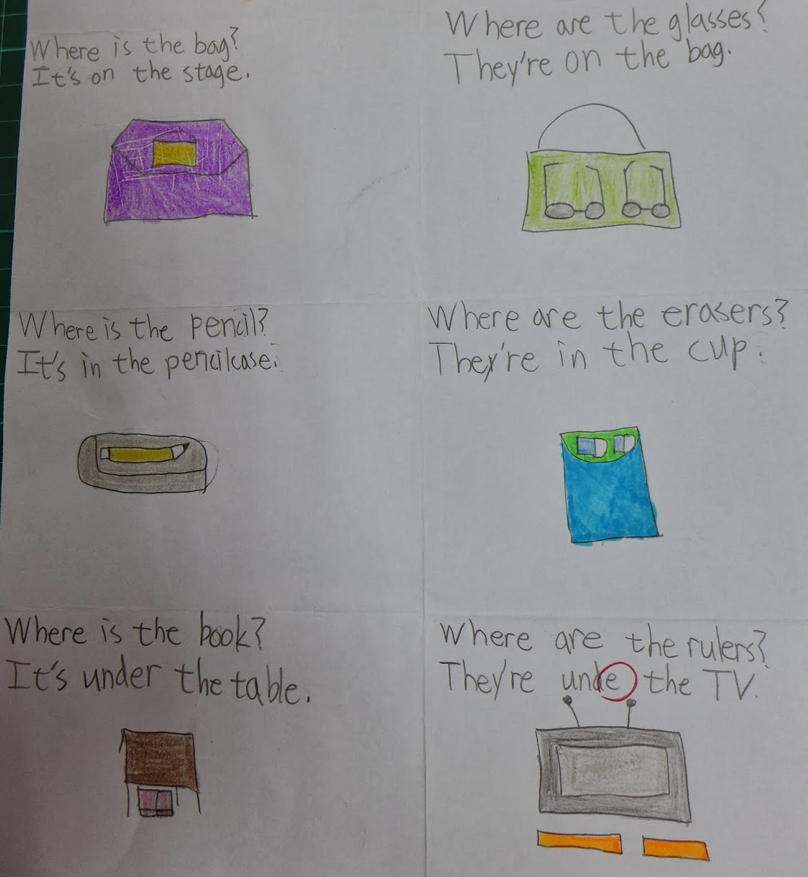

Slide 40
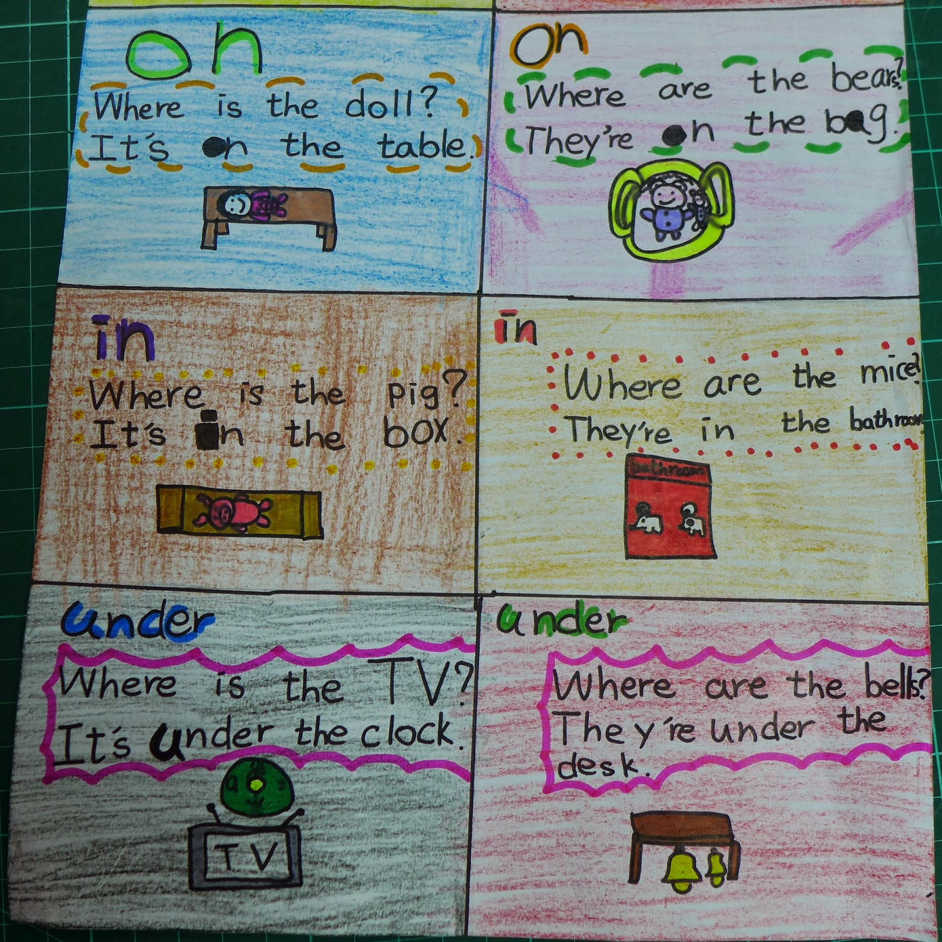

Slide 41
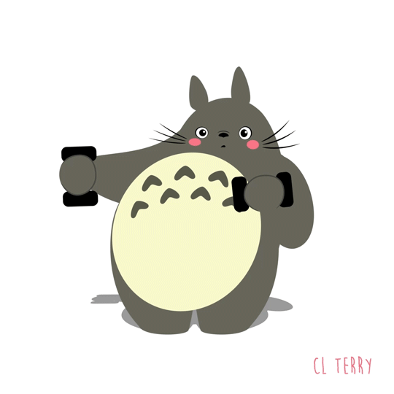
Preposition sentences
in
on
You can take a look on your book page 66.
under
next to

Slide 42
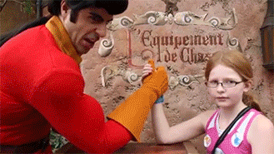
Harder Challenge!!!!!

Slide 43
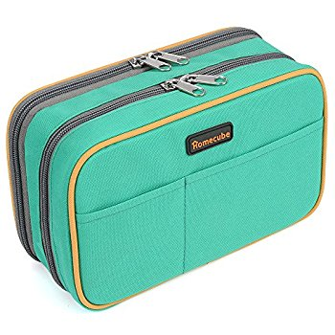
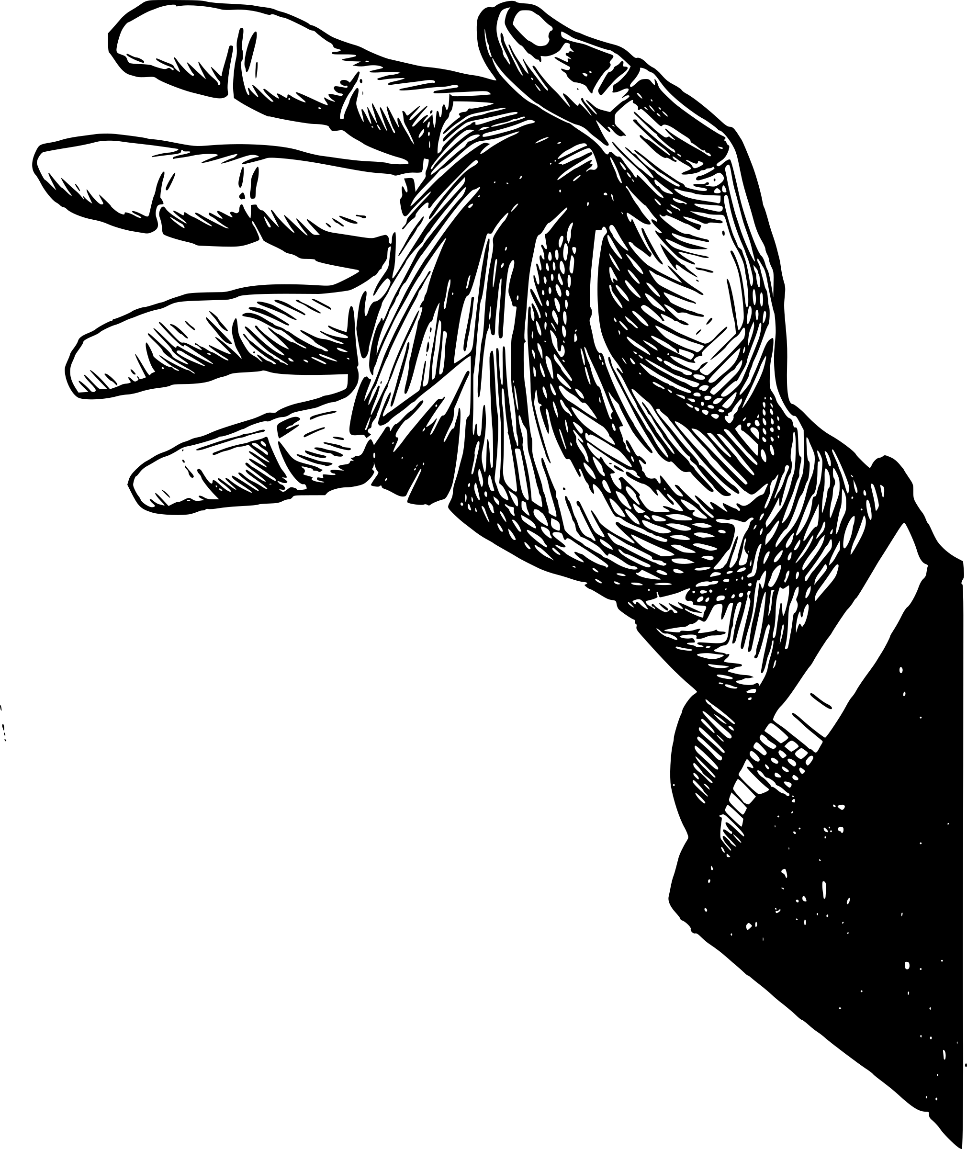
Prepare these things……

Slide 44
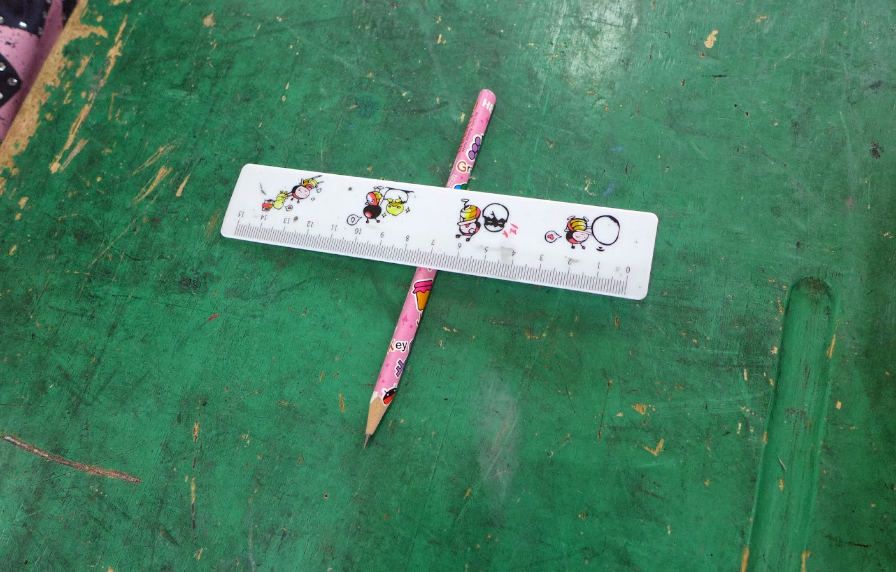
1. Clear your desk. 2. Put all things into the drawer. 3. After the instructions, you can put the things on the desk.

